Slide 1

One-Shot Learning with Siamese NN
Mr. Lee Twito
LeeTwito@gmail.com

Slide 2

One-Shot Learning
“one-shot learning aims to learn information about object categories from one, or only a few, training images.” - Wikipedia

Slide 3

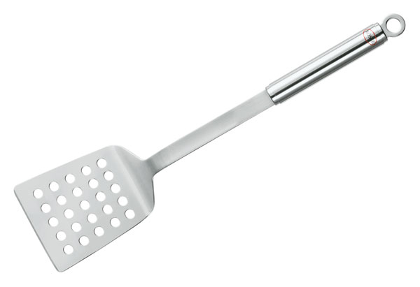



Slide 4
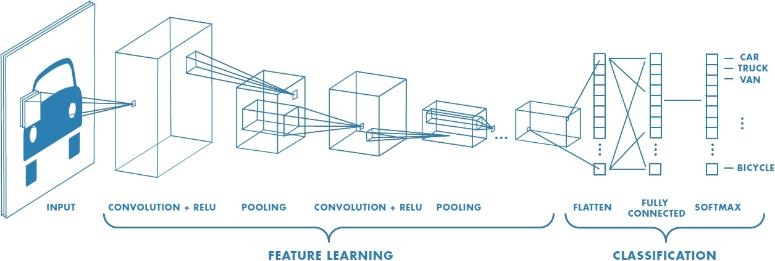
Goal: One-Shot learning (e.g. Face Validation)
Tool: Deep-Learning using Convolutional and Siamese Neural Networks

Slide 5

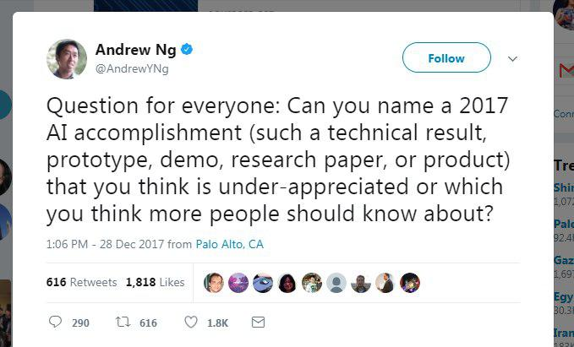
Idea for research

Slide 6

Motivation
Deep Learning systems producing state-of-the-art results in many fields, though they require a lot of data for training
Performance, Automatic high quality features extraction
Security, Search-Engines, Cyber
Sparse data problems:
  Face Verification
  Speaker recognition
  Similarity
  Factory defects

Slide 7
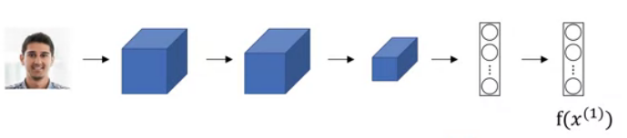
Picture to Features representation
Smaller
Generic

Slide 8
Using pre-trained net
High quality features extraction from complex structured and high dimensional data

Slide 9
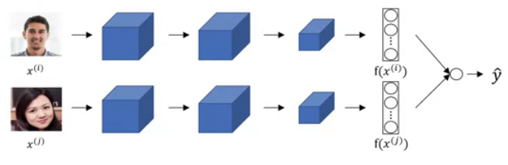
Siamese Network
New
Database
Decision rule

Slide 10


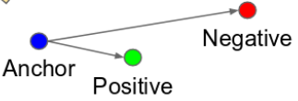
Decision rules
(Naive)
Manual:
(Sigmoid)
Binary classification:
Triplet loss:

Slide 11
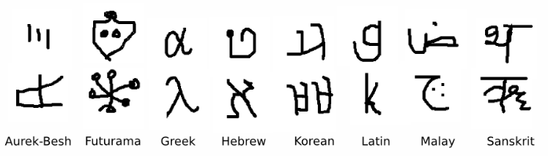
Omniglot dataset
50 Alphabets
1623 characters
20 writers for each character
~33 character per alphabet

Slide 12
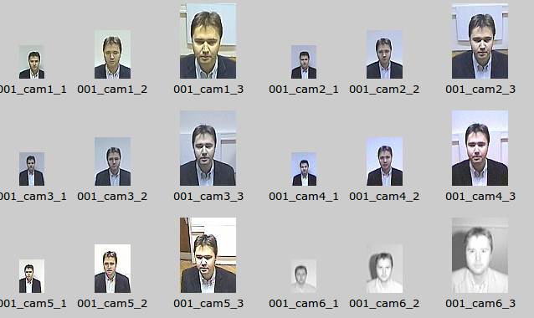
Wanted person -
Surveillance camera captures
SCface - Surveillance Cameras Face Database

Slide 13

More attitudes
Metric Learning using useful representation + KNN
Memory Augmented Network (DeepMind)

Slide 14

Thank you
Mr. Lee Twito
LeeTwito@gmail.com

Slide 15
